Slide 1


Enhancing UI/UX Accessibility: Practical Tips for Improved User Experience
Jamil Sinno
Sinno Technologies Limited
October 26, 2023

Slide 2
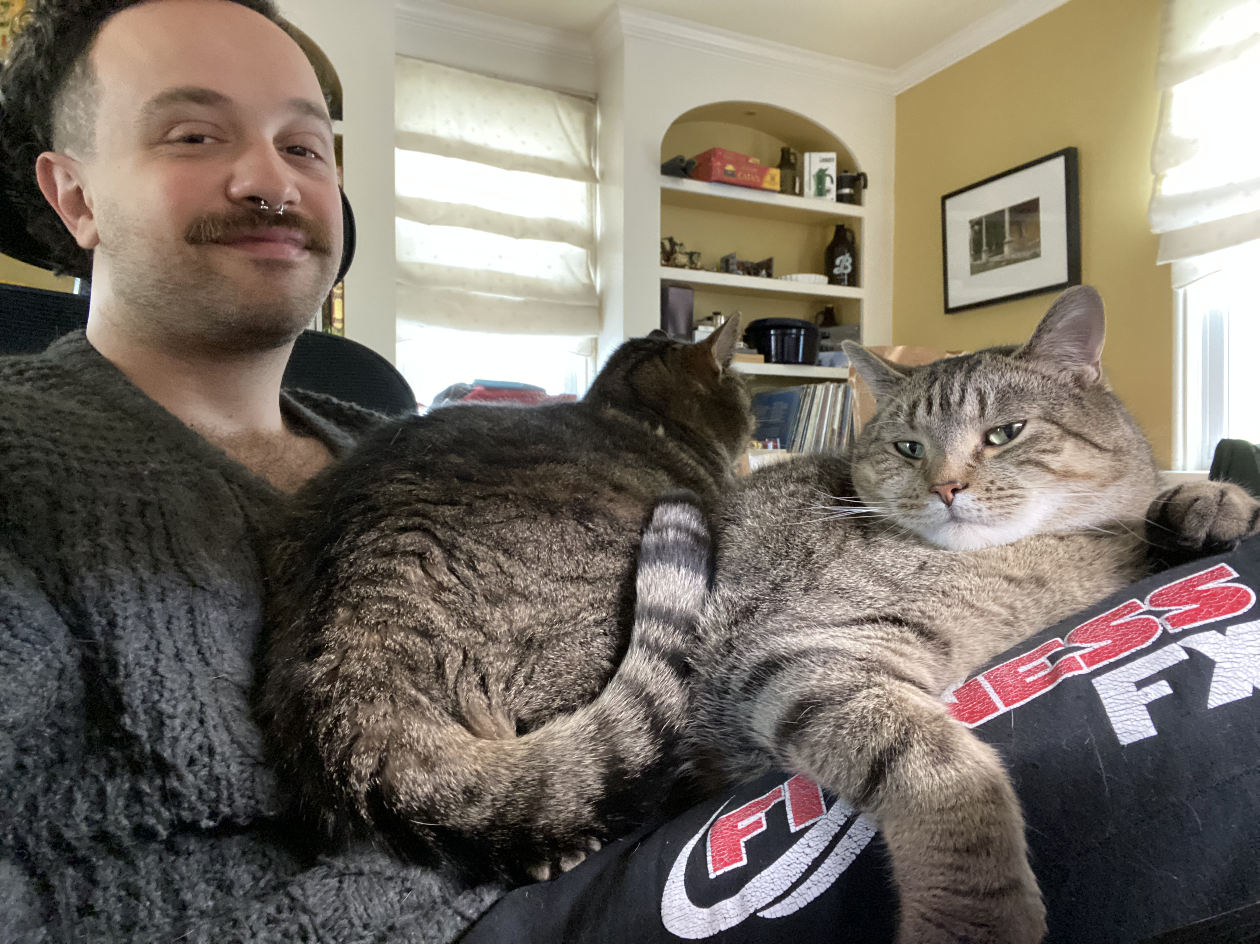
Who Am I?
Moved to Halifax in 2004
2 cat, Ed & Al
Cooking, working out, & playing the drums
Full Stack Web Developer & Founder
Passionate about making accessible products

Slide 3

The power of the Web is in its universality. Access by everyone regardless of disability is an essential aspect.
Tim Berners-Lee, W3C Director

Slide 4

What Does Accessibility Mean To You?
Notes:
breathe

Slide 5
Introduction
When websites and web tools are properly designed and coded, people with disabilities can use them.
World Accessibility Initiative (WAI) developed the Web Content Accessibility Guideline (WCAG).
Many sites are developed with accessibility barriers that make them difficult or impossible for some people to use.
Making the web accessible benefits individuals, business and society.
Notes:
breathe

Slide 6
Who Benefits From Accessibility?
People with physical, cognitive, neurological or psychological disabilities.
People with temporary disabilities.
When you are face with situational limitations.
Users with slow internet connection.
Notes:
sprained wrist, sprained finger, felt stiff
Baby stroller cut curb

Slide 7
WCAG – The Foundation
The Web Content Accessibility Guidelines provides a set of guidelines for creating accessible web content.
4 Principles behind the WCAG Acronym POUR:
Perceivable – your content can be navigated using any combination of senses.
Operable – cannot require an interaction specific users cannot perform.
Understandable – don't use complex language.
Robust - Users must be able to access your content using any device, include assistive tech.
Strive to attain AA-level accessibility standard.
Notes:
There are different standards you can achieve

Slide 8
The Disability Market
Almost 20% of the population globally identifies as living with a disability.
Only about 1% of the disabled population appears in mainstream media.
As of 2020, The Disability Market represents approximately US $8,000,000,000,000 in annual disposable income.
That number jumps up to US $13 trillion when taking into account friends and family.
Notes:
Last theory slide

Slide 9

Let's Be Practical
Notes:
breathe

Slide 10
Semantic HTML
Use appropriate HTML elements to structure content.
Semantic tags include, but are not limited to:
Header
Nav
Headings
Lists
Forms
Tables
Figures
Links
Notes:
breathe

Slide 11
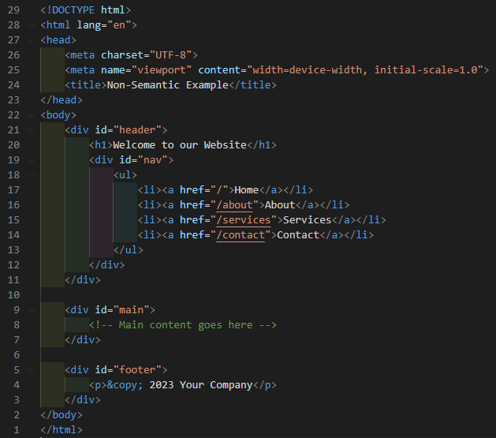
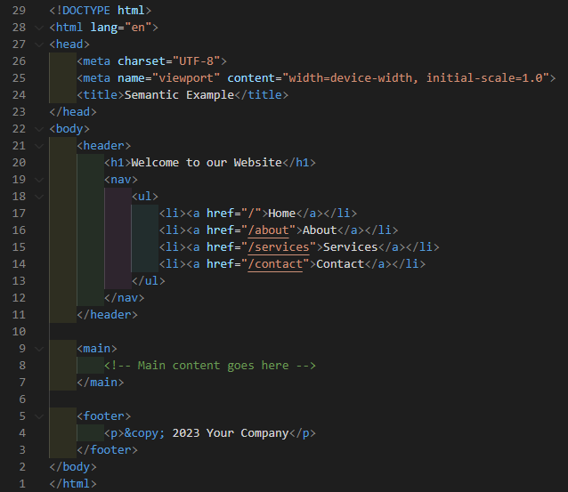
Non-semantic use of HTML
Semantic use of HTML
Notes:
Breathe
Illustrate the differences
Note the links and list items

Slide 12
Ensure Keyboard Accessibility
All interactive elements should be navigable and operable using only a keyboard.
Things you can do:
Visible keyboard focus indicator
A "skip to content" link
Logical tab order
Form accessibility
Regular keyboard testing
Notes:
breathe

Slide 13
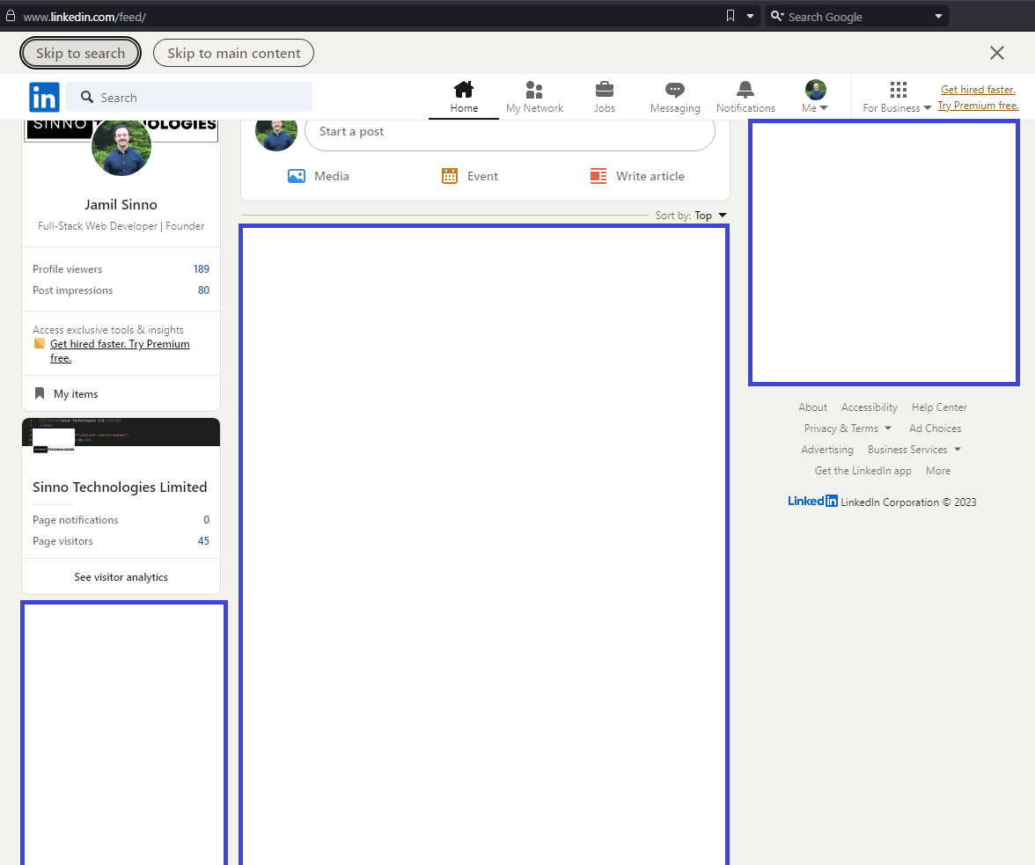

Slide 14
Enhance The Contrast
Maintain sufficient contrast between text and background colors.
Use a minimum 16 pixels or 12-point font for regular text.
A minimum of 3:1 color contrast ratio for non-text elements.
A minimum of 4.5:1 color contrast ratio for text elements.
Notes:
breathe

Slide 15
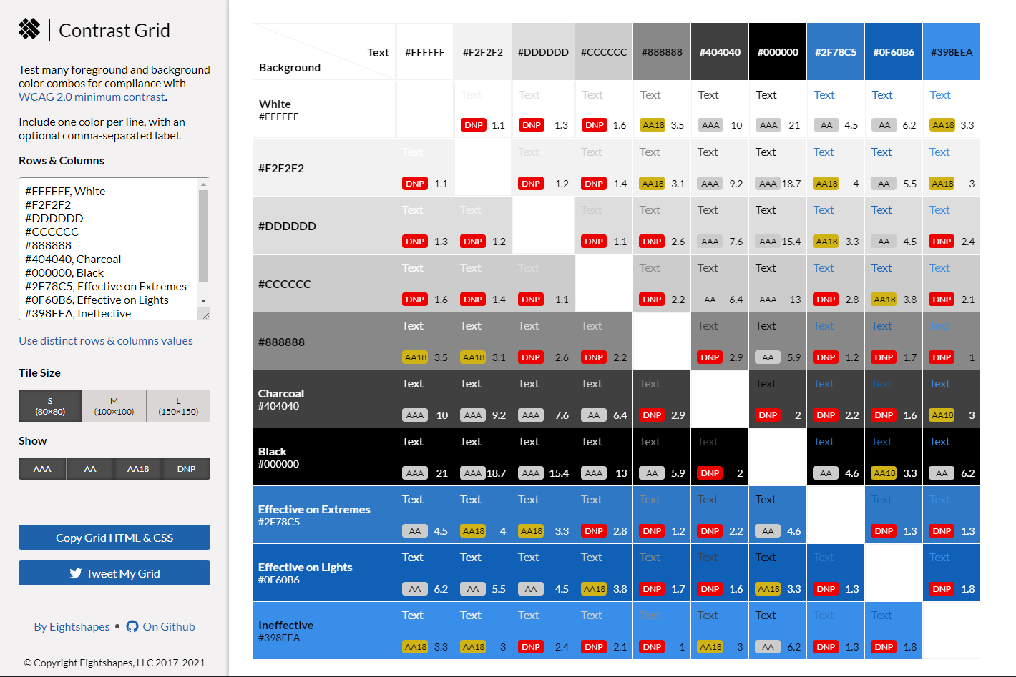
Source: https://contrast-grid.eightshapes.com
Notes:
Breathe
2 sections -- Standards legend – background text

Slide 16
Provide Alternative Text
Add informative alternate text to images and icons.
Describe images for non-visual users.
Convey image content, not generic labels.
Make the text relevant to the page and image's purpose.
Be concise yet informative.
Notes:
breathe

Slide 17
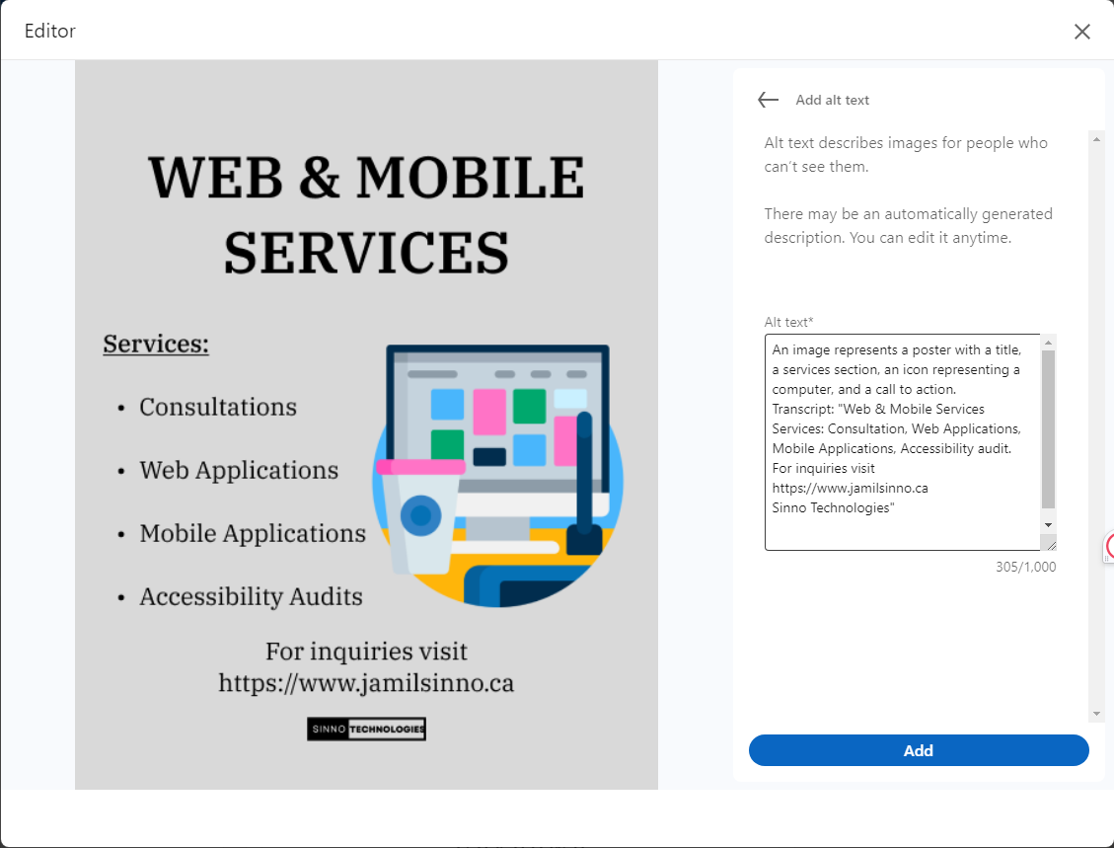
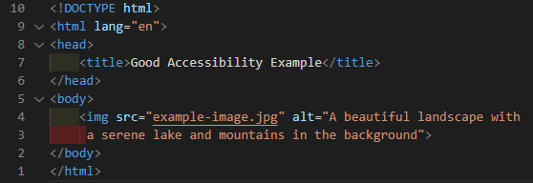
Notes:
breathe

Slide 18
Include Users With Disabilities
Conduct usability testing with individuals who have disabilities to gather feedback.
Conduct workshops and provide training to enhance accessibility awareness.
Establish accessible feedback channels for users to report issues.
Perform ongoing accessibility audits and commit to continuous improvement.
Compensate individuals for their work.
Notes:
breathe

Slide 19
Enhance Accessibility With ARIA
ARIA (Accessible Rich Internet Applications): ARIA attributes enhance accessibility for dynamic content.
Use ARIA roles and attributes to enhance the accessibility of complex UI components.
Prioritize using semantic HTML elements for accessibility.
ARIA should be a last resort when semantic HTML isn't sufficient.
Define element purpose and state using ARIA roles and attributes.
Notes:
State- whether things are checked (true), unchecked (false) or a combination of both

Slide 20
Automatic testing
Streamline web accessibility evaluation.
Rapidly scans websites for common accessibility issues.
Use these tools in conjunction with manual testing for a comprehensive assessment.
Some tools to consider using: Lighthouse, and ax DevTools.
Notes:
breathe

Slide 21
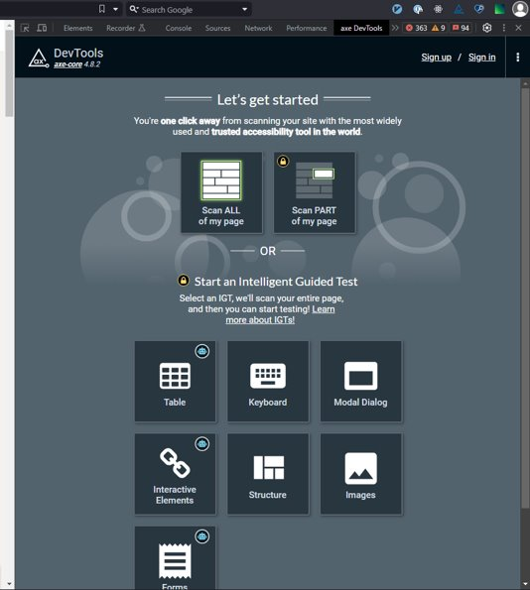
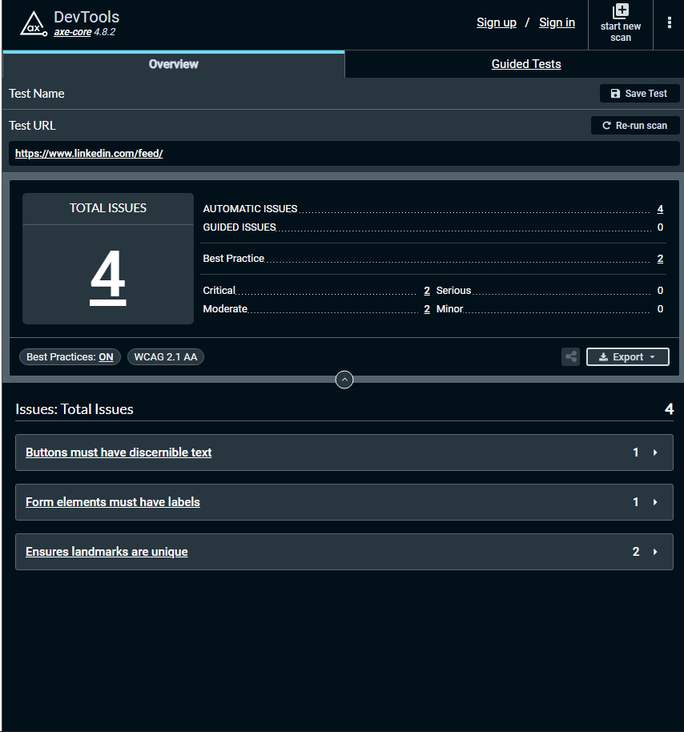
Notes:
breathe

Slide 22
Manual Testing
Automatic tests don't cover everything.
Things to check for:
Keyboard navigation – operate your app using only the keyboard.
Screen reader compatibility – use tools like NVDA Screen Reader.
Contrast and Scaling – Test on different browsers and screen sizes.
Alt text for images – inspect images manually for alternate text.
Navigate your application as if you have no access to a pointer
Document and report issues, collaborating with developers for solutions.

Slide 23
Make Accessibility A Continuous Effort
Accessibility is an ongoing commitment, not a one-time task.
Foster an accessibility culture.
Develop a roadmap for ongoing improvements.
Champion Accessibility.
Notes:
This is the last slide before links

Slide 24

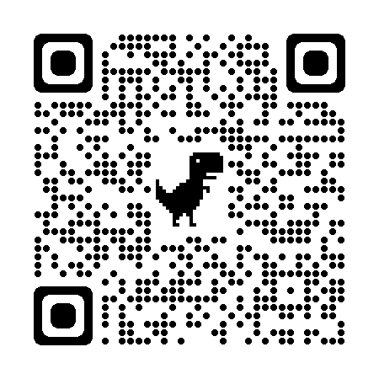
Where You Can Find Me

Slide 25
References
https://www.w3.org/TR/WCAG21/
https://noti.st/colabottles/eHPdlN
https://html.spec.whatwg.org/multipage/
https://webaim.org/
https://www.campaignasia.com/article/ignored-no-more-how-the-shift-20-initiative-is-normalising-disabled-people-in-ad/492186
https://wfanet.org/knowledge/diversity-and-inclusion/item/2020/09/01/The-Global-Economics-of-Disability-2020

